Slide 1
Lecture No. 03 Introduction to Computer Programming CP-CS161
Air University Multan Campus
Department of Computer Sciences
by Ahmad Mohsin

Slide 2
What we have covered in our Previous Lecture Series about Basics of Computing?
Lets Review

Slide 3
Today we shall cover
Programming Languages
Low Level Languages
High Level Languages
Compilers, Linkers, Interpreters
Programming & Problem Solving
Algorithms, Flowcharts
Program Design Process
Skills Required

Slide 4
What is Programming?
What Really Programming Means?
Definition: "A program is a precise sequence of steps to solve a particular problem.”
it actually mean that we know about a
complete set activities to be performed in a particular order

Slide 5
Contd…
When we talk about computer programming then as Mr. Steve Summit puts it..
“At its most basic level, programming a computer simply means telling it what to do
Planning --- Organizing & Paying attention to the Details.

Slide 6
Interesting Fact….Father & Mother of Computing
Charles Babage ----- Analytical Engine—Digital Computing
ADA --- First Ever Computer Programmer
Countess of Lovelace
DOD USA Department of Defence Developed Ada for programming Military Applications.

Slide 7
Programming Language
All software programs, from Microsoft Windows 7 to Word 2010, skype, MSN etc. are written in a programming language.
A programming language is a vocabulary and set of grammatical rules for instructing a computer to perform specific tasks.

Slide 8
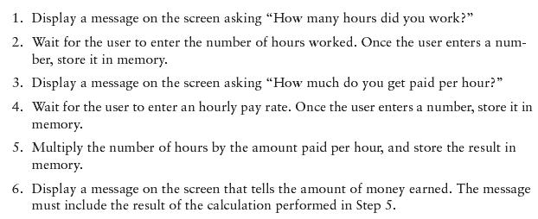
Example Algorithm for Calculating Gross Pay

Slide 9
Machine Language
Although the previous algorithm defines the steps for calculating the gross pay, it is not ready to be executed on the computer.
The computer only executes machine language instructions

Slide 10
Machine Language
Machine language instructions are binary numbers, such as 1011010000000101
Rather than writing programs in machine language, programmers use programming languages.

Slide 11
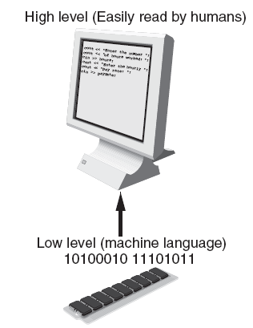
Programs and Programming Languages
Types of languages:
Low-level: used for communication with computer hardware directly. Often written in binary machine code (0’s/1’s) directly.
High-level: closer to human language

Slide 12
Some Well-Known Programming Languages (Table 1-1 on Page 10)
C++
BASIC
Ruby
Java
FORTRAN
Visual Basic
C#
COBOL
JavaScript
C
Python

Slide 13
From a High-Level Program to an Executable File
Create file containing the program with a text editor.
Run preprocessor to convert source file directives to source code program statements.
Run compiler to convert source program into machine instructions.
Run linker to connect hardware-specific code to machine instructions, producing an executable file.
Steps b–d are often performed by a single command or button click.
Errors detected at any step will prevent execution of following steps.

Slide 14
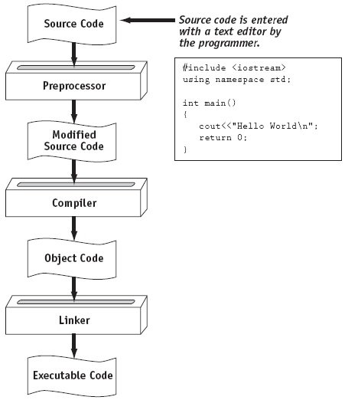
From a High-Level Program to an Executable File

Slide 15
Integrated Development Environments (IDEs)
An integrated development environment, or IDE, combine all the tools needed to write, compile, and debug a program into a single software application.
Examples are Microsoft Visual C++, Turbo C++ Explorer, CodeWarrior, etc.

Slide 16
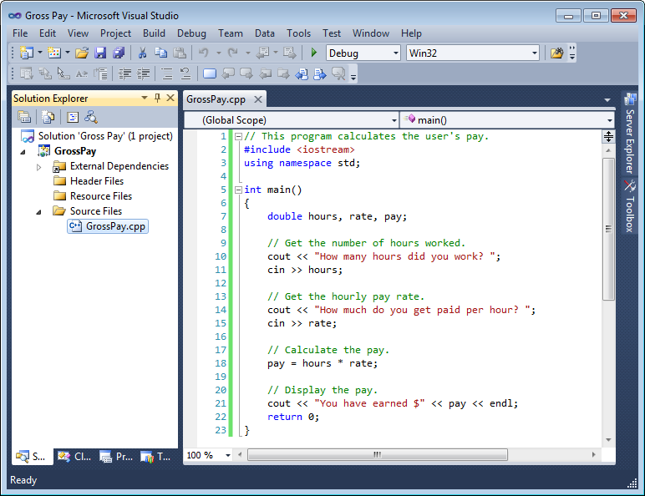
Integrated Development Environments (IDEs)

Slide 17
What Computers can Understand?
Computer can only understand Machine language …and what is machine language … it is a language understandable by Machines only which is in Numbers.

Slide 18
Types of Programming Languages
Low Level Languages
High Level Languages

Slide 19
Low level Languages
Machine Language
The lowest-level programming language, machine languages can be read by computers, but are almost impossible for humans to use because they consist entirely of numbers. Machine Languages are Machine Dependent.
Example: (Overtime Pay to base pay and stores in Gross pay)
+12334444
+14005555
+343434343

Slide 20
Low Level Languages .. Contd...
Assembly Languages
Assembly languages have the same structure and set of commands as machine languages, but they enable a programmer to use names instead of numbers when writing code. Translators called Assemblers are used to covert Assembly Language program into Machine Language.
Example
Load basepay
Add overpay
Store grosspay

Slide 21
High Level Languages
These are the languages understandable by humans easily. A person can write a program with the help of these languages very easily.
Translator Programs called compilers convert High level language code into Machine language.
A single statement usually accomplishes a set of tasks.
Example
Grosspay=basepay+overtimepay

Slide 22
Language Translators
Human programmers write programs in a language that is easy to understand for them. They use language translators to convert that program into machine language. It converts the human understandable code into object code which is machine understandable code.
Compilers
Interpreters
Assemblers

Slide 23
What is a Program Made of?
Common elements in programming languages:
Key Words
Programmer-Defined Identifiers
Operators
Punctuation
Syntax

Slide 24
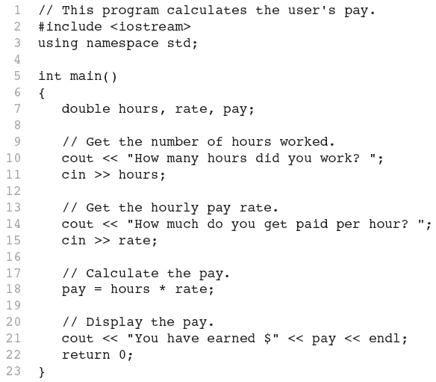
Program 1-1

Slide 25
Key Words
Also known as reserved words
Have a special meaning in C++
Can not be used for any other purpose
Key words in the Program 1-1: using, namespace, int, double, and return

Slide 26
Key Words

Slide 27
Programmer-Defined Identifiers
Names made up by the programmer
Not part of the C++ language
Used to represent various things: variables (memory locations), functions, etc.
In Program 1-1: hours, rate, and pay.

Slide 28
Operators
Used to perform operations on data
Many types of operators:
Arithmetic - ex: +,-,*,/
Assignment – ex: =
Some operators in Program1-1: << >> = *

Slide 29
Operators

Slide 30
Punctuation
Characters that mark the end of a statement, or that separate items in a list
In Program 1-1: , and ;

Slide 31
Punctuation

Slide 32
Syntax
The rules of grammar that must be followed when writing a program
Controls the use of key words, operators, programmer-defined symbols, and punctuation

Slide 33
Variables
A variable is a named storage location in the computer’s memory for holding a piece of data.
In Program 1-1 we used three variables:
The hours variable was used to hold the hours worked
The rate variable was used to hold the pay rate
The pay variable was used to hold the gross pay

Slide 34
Variable Definitions
To create a variable in a program you must write a variable definition (also called a variable declaration)
Here is the statement from Program 1-1 that defines the variables: double hours, rate, pay;

Slide 35
Variable Definitions
There are many different types of data, which you will learn about in this course.
A variable holds a specific type of data.
The variable definition specifies the type of data a variable can hold, and the variable name.

Slide 36
Variable Definitions
Once again, line 7 from Program 1-1: double hours, rate, pay;
The word double specifies that the variables can hold double-precision floating point numbers. (You will learn more about that in Chapter 2)

Slide 37
Compilers
Compiler translates the program written in a HLL in one go. The translated code is then used by the Machines whenever the program needs to be run.
Compilers covert High level language code into Machine Code also called object code.
They do compile a program or set of instructions with one click.
Usually are FAST
Compilers usually use Editors to take instructions.
Examples..

Slide 38
Interpreters
Interpreter is a program that executes instructions written in a high-level language
An interpreter translates high-level instructions into an intermediate form step by step, which it then executes. In contrast, a compiler translates high-level instructions directly into machine language.
Compiled programs generally run faster than interpreted programs

Slide 39
Linkers
A linker links the object code with the libraries it then creates an executable file and stores on the disk.
With Every compiler linker is necessary to be there in order to execute the code.

Slide 40
Programming & Problem solving
Problem Solving
When faced with a problem:
We first clearly define the problem
Think of possible solutions
Select the one that we think is the best under the prevailing circumstances
And then apply that solution
If the solution woks as desired, fine; else we go back to step 2

Slide 41
Contd..
It is quite common to first solve a problem for a particular case
Then for another
And, possibly another
And watch for patterns and trends that emerge
And to use the knowledge form those patterns and trends in coming up with a general solution

Slide 42
Input, Processing, and Output
Three steps that a program typically performs:
Gather input data:
from keyboard
from files on disk drives
Process the input data
Display the results as output:
send it to the screen
write to a file

Slide 43
Algorithms
Sequence of steps that can be taken to solve a given problem.
Examples
Addition
Conversion from decimal to binary
The process of boiling an egg
The process of mailing a letter
Sorting
Searching

Slide 44
Origin of the Term “Algorithm”
The name derives from the title of a Latin book: Algoritmi de numero Indorum
That book was a translation of an Arabic book: Al-Khwarizmi Concerning the Hindu Art of Reckoning
That book was written by the famous 9-th century Muslim mathematician,
Muhammad ibn Musa al-Khwarizmi

Slide 45
Al-Khwarizmi’s Golden Principle
All complex problems can be and must be solved
using the following simple steps:
Break down the problem into small, simple sub-problems
Arrange the sub-problems in such an order that each of them can be solved without effecting any other
Solve them separately, in the correct order
Combine the solutions of the sub-problems to form the solution of the original problem

Slide 46
Example
Example
Algorithm for Decimal-to-Binary Conversion
(75)10 = (Binary Number)2
Algorithm
Write the decimal number
Divide by 2; write quotient and remainder
Repeat step 2 on the quotient; keep on repeating until the quotient becomes zero
Write all remainder digits in the reverse order (last remainder first) to form the final result

Slide 47
Three Requirements for Algorithms
Three Requirements:
Sequence is:
Precise
Consists of a limited number of steps
Each step is:
Unambiguous
Executable
The sequence of steps terminates in the form of a solution

Slide 48
Analysis of Algorithm
Computational time
Memory
Bandwidth
Logic functions

Slide 49
Flowcharts
A graphical representation of a process (e.g. an algorithm), in which graphic objects are used to indicate
the steps & decisions that are taken as the process moves along from start to finish
Individual steps are represented by boxes and other shapes on the flowchart, with arrows between those
shapes indicating the order in which the steps are taken

Slide 50
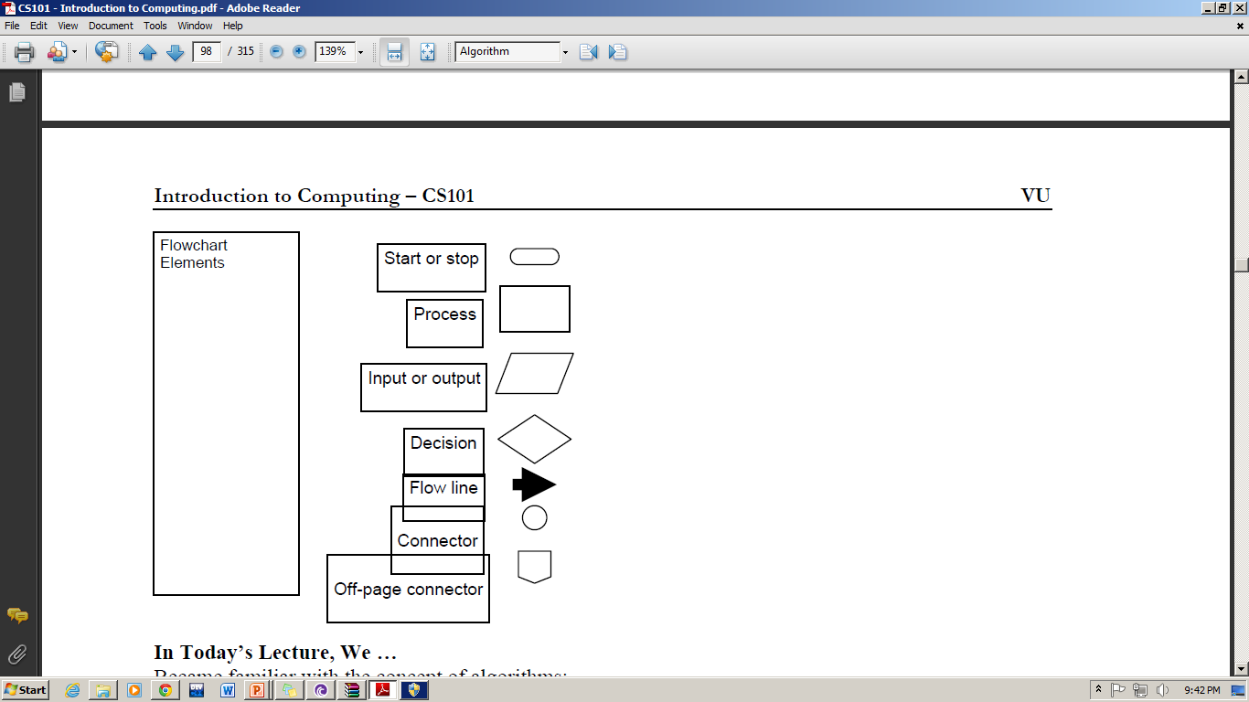
Flow Charts Elements

Slide 51
All problems can be solved as
Sequences
Conditionals
Loops

Slide 52
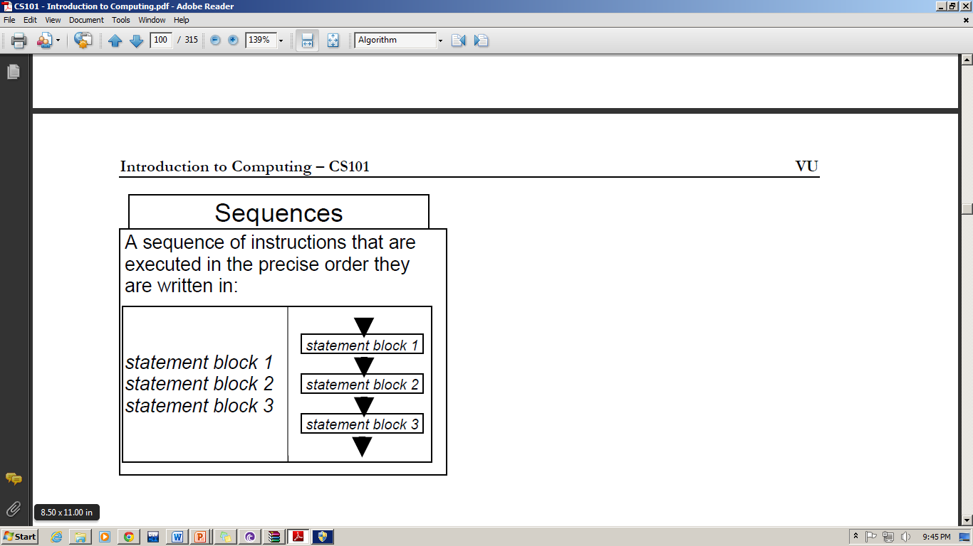
Sequences

Slide 53
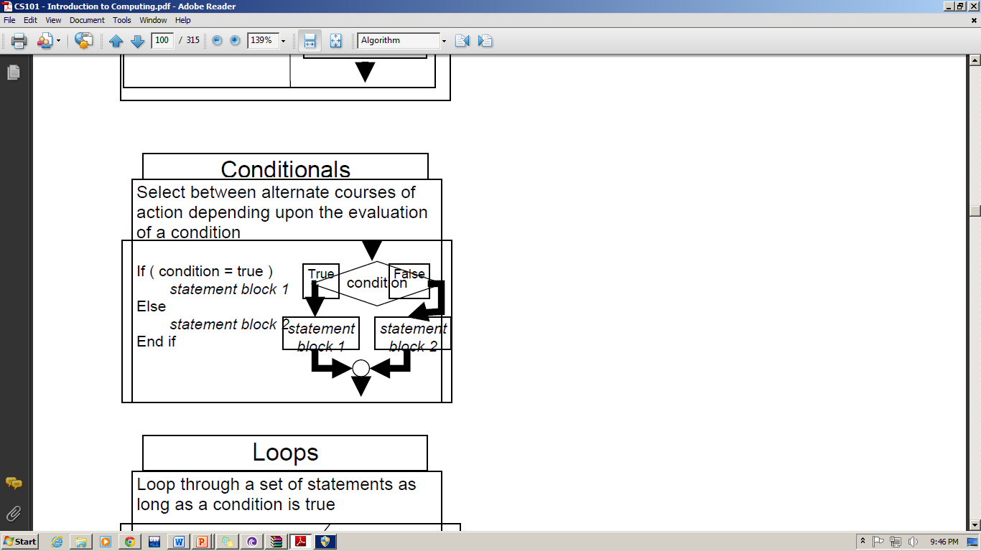
Conditions

Slide 54
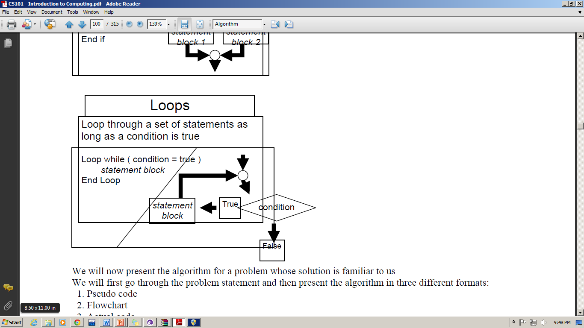
Loops

Slide 55
Program Deign Process
Requirements Analysis
Design
Coding
Testing
Deployment

Slide 56
What skills are Required for Programming?
Attention to Details
Care for Reusability
Think of user Friendliness
Understand that Computers are stupid

Slide 57
Lets Summarize

Slide 58
References
Computer Basics: Custom Guide 2007, © 2007 Custom Guide, Inc
C++ How to Program Dietel & Dietel 6th Edition
Tony Gaddis early chapters

